Slide 1

Heart Disease Prediction Using Machine Learning
Tarık Koçak-İldeha Kale

Slide 2
What is the PROBLEM ?
Cardiovascular diseases (CVDs), including heart disease, are the leading cause of death worldwide. In 2019, 17.9 million people died from CVDs, accounting for 32% of all global deaths, with 85% due to heart attacks and strokes.
The global burden of CVDs has grown significantly, with deaths rising from 12.1 million in 1990 to 20.5 million in 2021—a 60% increase in three decades. In the United States, heart disease remains a major concern, causing 702,880 deaths in 2022, or 1 in every 5 deaths.
These statistics highlight the urgent need for prevention, early detection, and effective treatment. Traditional diagnostic methods, while critical, are often time-consuming, costly, or invasive, underscoring the need for innovative, non-invasive solutions like machine learning-based predictive models.
https://www.who.int/news-room/fact-sheets/detail/cardiovascular-diseases-%28cvds%29
https://world-heart-federation.org/news/deaths-from-cardiovascular-disease-surged-60-globally-over-the-last-30-years-report
https://www.cdc.gov/heart-disease/data-research/facts-stats/index.html

Slide 3
Our Objective
Develop machine learning models to predict the likelihood of heart disease using patient data such as age, cholesterol levels, and blood pressure. These models aim to deliver a fast, accurate, and non-invasive diagnostic tool, enhancing early detection and enabling timely medical interventions.

Slide 4
Related Works
Choudhury et al. (2017)
Developed a hybrid model combining Decision Trees and Random Forests for heart disease prediction, achieving 88% accuracy.
Rajkumar and Reena (2019)
Compared SVM, Naïve Bayes, and Logistic Regression for heart disease classification, with SVM achieving the highest accuracy of 85.6%.
Dinesh et al. (2020)
Applied Deep Neural Networks (DNN) for heart disease prediction, achieving 90% accuracy and showing the effectiveness of deep learning in medical datasets.
Yadav et al. (2021)
Used k-Nearest Neighbors (kNN) and Genetic Algorithms for feature selection, achieving an F1 score of 0.91 in heart disease prediction.
Balamurugan et al. (2022)
Proposed an ensemble method using Random Forest and XGBoost for heart disease prediction, improving accuracy and handling class imbalance.

Slide 5

Challenges in Field

Slide 6
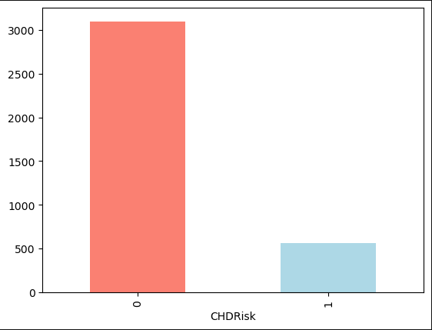
1. Data Quality and Availability:
Many datasets are imbalanced, with a higher number of healthy cases than heart disease cases, and missing or noisy data, such as patient-reported symptoms, can negatively impact model performance.

Slide 7

2. Feature Importance and Selection
Identifying the most predictive features, like cholesterol levels, smoking, or diabetes, is challenging, and irrelevant or redundant features can introduce noise and reduce model accuracy.

Slide 8

3. Bias and Fairness
Models trained on specific demographic data may not generalize well to other populations, and there are ethical concerns about unintentional bias favoring certain groups.

Slide 9

4. Interpretability vs. Accuracy
While complex models like Random Forest and SVM achieve high accuracy, they lack interpretability, which is essential in healthcare for understanding and trusting the predictions.

Slide 10

Machine Learning Workflow
1. Data Preprocessing:
Data preprocessing involves cleaning the dataset by handling missing values, normalizing features to a common scale, and selecting the most relevant features to improve model performance.
2. Model Selection:
The models selected for prediction include Logistic Regression for linear relationships, Random Forest and Decision Tree for handling complex, non-linear data, and Support Vector Machine (SVM) for high-dimensional classification tasks.
3. Hyperparameter Tuning:
Hyperparameter tuning is performed using RandomizedSearchCV for efficient exploration of parameter spaces and GridSearchCV for exhaustive search to optimize model performance.
4. Evaluation Metrics:
Evaluation is based on accuracy, precision, recall, and F1 score to assess the model's performance, balancing overall accuracy with the ability to handle false positives and false negatives effectively.

Slide 11
Model Results
First Dataset (Before Hyperparameter Tuning):
The max performance was achieved by the Random Forest (Gini) model with an accuracy of 0.8728.
The min performance was observed in the Decision Tree (Entropy) model with an accuracy of 0.7721.
The average accuracy across all models was 0.8432.
First Dataset (After Hyperparameter Tuning - RandomizedSearchCV):
The max performance was achieved by the SVC model with an accuracy of 0.8626.
The min performance was observed in the Random Forest model with an accuracy of 0.8462.
The average accuracy across the three models was 0.8553.
First Dataset (After Hyperparameter Tuning - GridSearchCV):
The max performance was achieved by the Logistic Regression model with an accuracy of 0.8516.
The min performance was observed in the Random Forest model with an accuracy of 0.8407.
The average accuracy across the two models was 0.8461.

Slide 12
Second Dataset (Before Hyperparameter Tuning):
The max performance was achieved by the Logistic Regression model with an accuracy of 0.8374.
The min performance was observed in the Decision Tree model with an accuracy of 0.75.
The average accuracy across the four models was 0.8132.
Second Dataset (After Hyperparameter Tuning - GridSearchCV):
The max performance was achieved by the Random Forest model with an accuracy of 0.8545.
The min performance was observed in the Logistic Regression model with an accuracy of 0.8388.
The average accuracy across the two models was 0.8467.
Second Dataset (After Hyperparameter Tuning - RandomizedSearchCV):
The max performance was achieved by the Logistic Regression model with an accuracy of 0.8555
The min performance was observed in the Random Forest Classifier model with an accuracy of 0.8368
The average accuracy across the two model was 0.8461

Slide 13
Brief of model results
Across both datasets, SVM (Support Vector Machine) consistently delivered strong performance, achieving the highest accuracy in the heart disease prediction dataset and maintaining competitive results in the second dataset. Logistic Regression also performed well in both cases, particularly excelling in the second dataset with the highest accuracy. Random Forest showed solid results but generally lagged behind SVM and Logistic Regression in both datasets after hyper tuning. Decision Tree, however, performed poorly in the second dataset, with the lowest accuracy.

Slide 14
Overall Conclusion
SVM and Logistic Regression are the most reliable models, with SVM being slightly more effective on the heart disease dataset and Logistic Regression leading on the second dataset. Random Forest can be a good alternative, while Decision Tree should be considered only when model simplicity is prioritized over accuracy.
These results emphasize the importance of selecting the right model based on the dataset and defining an appropriate hyperparameter search space. Proper model choice and tuning improve performance, generalization, and avoid overfitting. While SVM and Logistic Regression excel in heart disease prediction, testing various models and understanding their strengths is key. Decision Trees, though useful, were outperformed here, highlighting the need for careful algorithm selection.

